Slide 1
Creating Attractive Web Pages

Slide 2
Objectives
In this session, you will learn to:
  Apply effects to HTML elements
  Use custom fonts

Slide 3
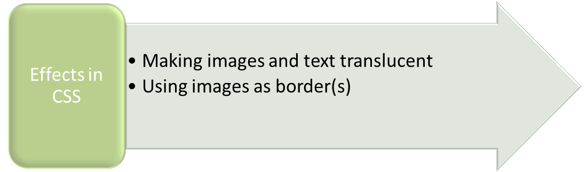
Applying Effects to HTML Elements
To enhance the appearance of a website, various effects can be applied to the HTML elements on a Web page.
CSS enables you to provide different visual effects to websites.

Slide 4
Making Images and Text Translucent
Sometimes, an image or text needs to be displayed in a translucent form.
To apply such an effect, CSS provides a property named opacity.
The syntax to use the opacity property is:
  opacity:value;
The opacity property takes a value from 0.0 to 1.0 where:
  0.0 represents 100% transparency.
  1.0 represents 100% opacity.
Both the text and the background colour are affected by the opacity level.
If text is typed in a box and the box is made transparent, the text inside the box will become transparent automatically.

Slide 5
Just a Minute
You can set the transparency of an image by using the ______ property.

Slide 6
Just a Minute (Contd.)
Answer:
  opacity

Slide 7

Using Images as Borders
An image can be used as a border around the text to display text in such a way that it catches the attention of every user.
For example, the following image can be used to make border.
To display the preceding image as a border around the text, you can use the border-image property provided by CSS.
The syntax of the border-image property is shown in the following code snippet:
border-image: source width outset repeat|round|stretch;

Slide 8
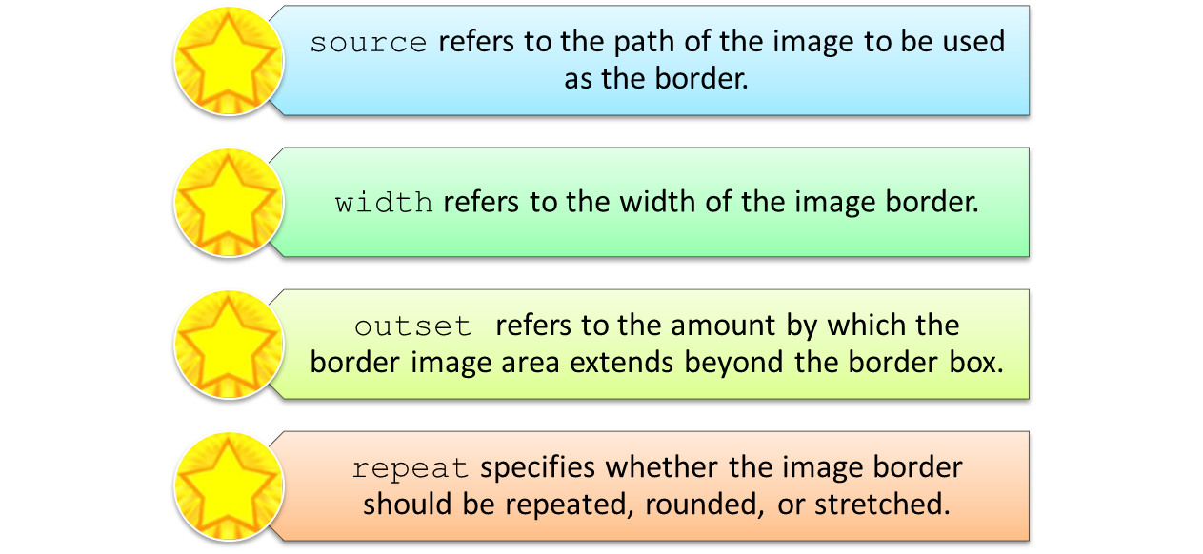
Using Images as Borders (Contd.)
In the preceding syntax.

Slide 9
Using Images as Borders (Contd.)
The following code snippet displays the image as a border around the text:
  <head>
  <style>
  div {
  border: 15px solid transparent;
  width: 150px;
  padding: 10px 20px;
  font-weight: bold;
  color: navy;
  font-family: 'Estrangelo Edessa';
  font-size: 16px;
  }
  #ID1 {
  border-image: url(images/star.png) 20 20 round;
  }
  </style>
  </head>
  <body>
  <div id="ID1">Apply for scholarship</div>
  </body>

Slide 10

Using Images as Borders (Contd.)
The following figure shows the output of the preceding code snippet.

Slide 11
Just a Minute
You can provide an image as a border to text by using the ______ property.
  border:image
  image-border
  border-image
  image:border

Slide 12
Just a Minute (Contd.)
Answer:
  border-image

Slide 13
Just a Minute
___________ refers to the amount by which the border image area extends beyond the border box.
  source
  slice
  width
  outset

Slide 14
Just a Minute (Contd.)
Answer:
  outset

Slide 15
Activity: Applying Effects
The management of the FoodHub food chain wants to add some effects in the home page of the website. For this, it asks you to add the following effects:
  Make the images present in the image gallery a little transparent. Whenever the user hovers the mouse pointer over these images, the images should look clear.
  Whenever the user hovers the mouse pointer over the images in the Cuisines We Offer section, the images should appear enlarged. In addition, the title for the image should appear below it.
Use the animation, RWD_02_Applying_Effects_to_a_Web_Page, to
understand how to apply different types of effects on HTML elements.

Slide 16

Activity: Applying Effects (Contd.)
The home page should appear, as shown in the following figure.
Prerequisite: To perform this activity, you need to use the solution of FoodHub
that you have created in Activity 2.1.

Slide 17
Using Custom Fonts
The @font-face rule of CSS allows you to use custom fonts on your website.
Using the @font-face rule, the text is displayed on the user’s device in the desired font only, even if it is not installed on the user’s device.
The custom fonts can be used without installing them on each system from where your website needs to be accessed.

Slide 18
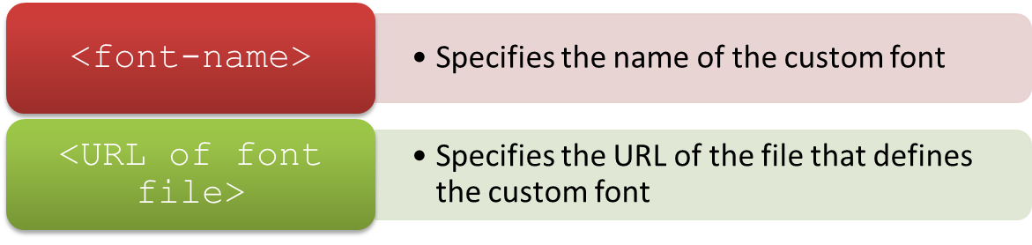
Using Custom Fonts (Contd.)
The syntax of the @font-face rule is shown in the following code snippet:
In the preceding syntax.
  @font-face
  {
  font-family: <font-name>;
  src: <URL of font file>;
  }

Slide 19
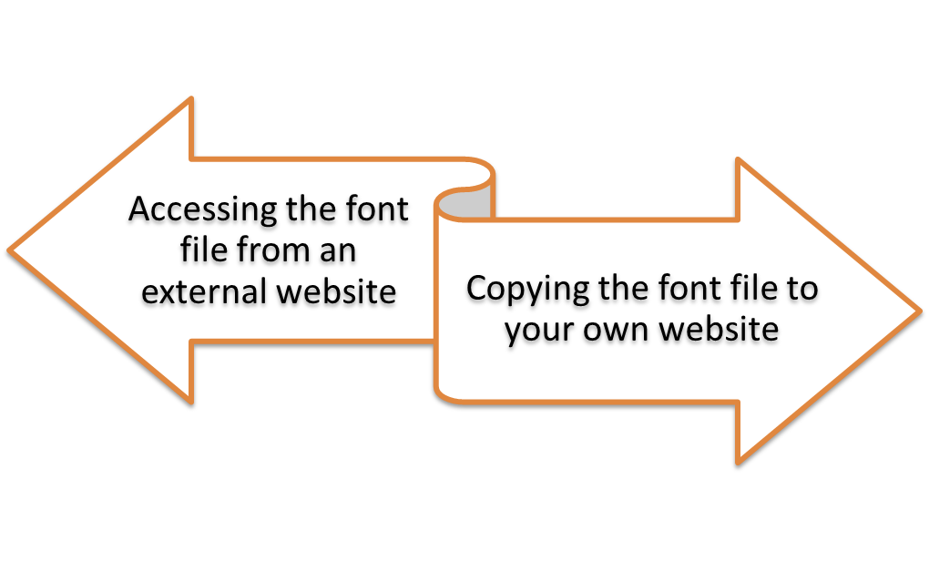
Using Custom Fonts (Contd.)
There are two methods to define a font through the @font-face rule.
These two methods are.

Slide 20
Accessing the Font File from an External Website
To access the font file from an external website, you need to provide the URL of the font file as the value of the style attribute, src, as shown in the following code snippet:
  <head>
  <style>
  @font-face
  {
  font-family: myfont;
  src:
  url("https://mdn.mozillademos.org/files/2468/VeraSeBd.ttf");
  }
  .techlabs
  {
  font-family: myfont;
  font-size: 40px;
  }
  </style>
  </head>
  <body>
  <div class="techlabs">TechLabs Inc.</div>
  </body>

Slide 21

Accessing the Font File from an External Website (Contd.)
In the preceding code snippet, a font named myfont has been created.
The URL of an external website is provided as the value of the src attribute to access the font, VeraSeBd.ttf.
The output of the preceding code snippet is shown in the following figure.

Slide 22
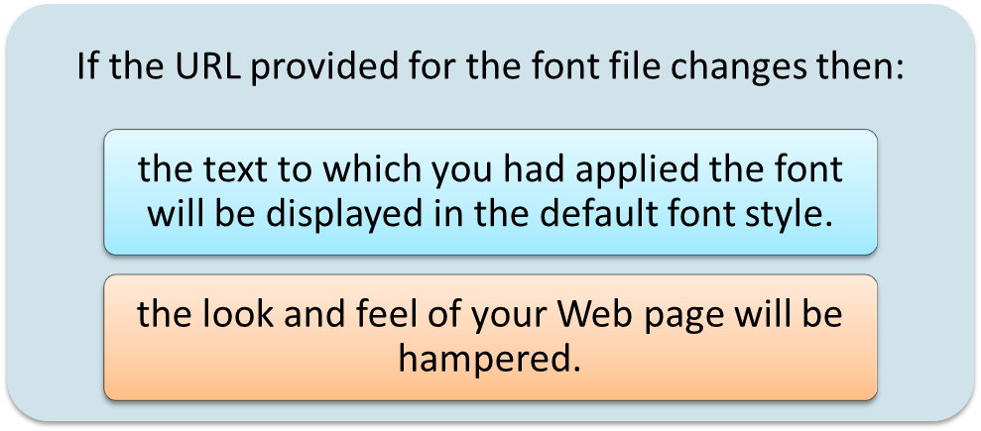
Copying the Font File to Your own Website
When accessing the font file from an external website, the following problem can arise.
To avoid such a situation, you can download the font from the Internet and add it your website.

Slide 23
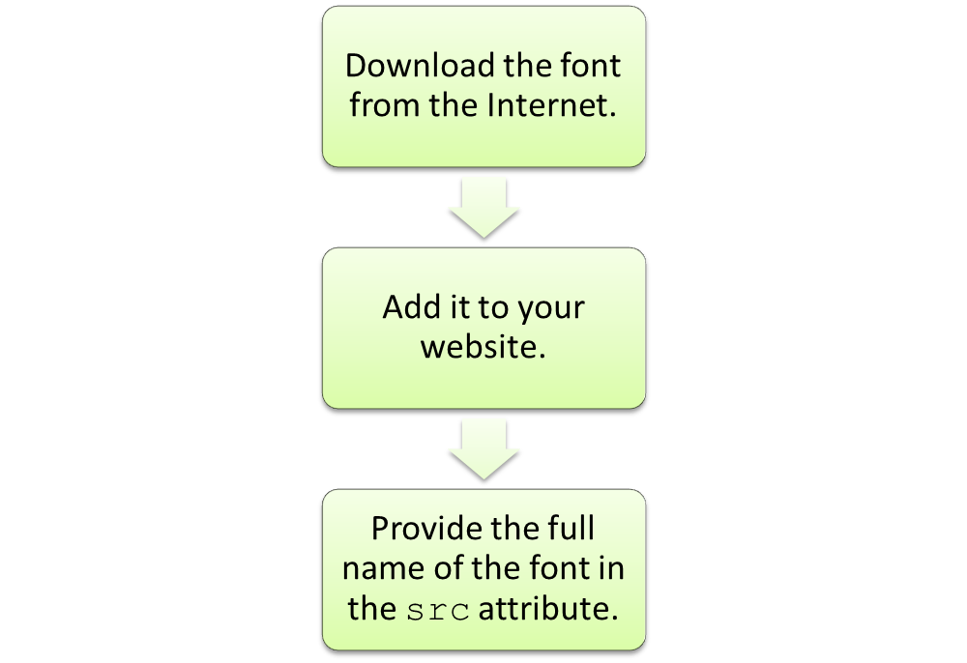
Copying the Font File to Your own Website (Contd.)
To copy the font file to your own website, you need to perform the following steps.

Slide 24
Copying the Font File to Your own Website (Contd.)
The following snippet shows the code to copy the font file to your own website:
    <head>
    <style>
    @font-face
    {
    font-family: myfont;
    src: url('VeraSeBd.ttf');
    }
    .techlabs
    {
    font-family: myfont;
    font-size: 40px;
    }
    </style>
    </head>
    <body>
    <div class="techlabs">TechLabs Inc.</div>
    </body>

Slide 25

Copying the Font File to Your own Website (Contd.)
In the preceding code snippet, a font named myfont is created.
Instead of the complete URL of an external site where the font resides, only the full name of the font, VeraSeBd.ttf, is given in the src attribute.
The output of the preceding code snippet is shown in the following figure.

Slide 26
Summary
In this session, you learned that:
  CSS enables you to apply different effects to HTML elements. Some of these effects are:
    Making images and text translucent
    Using images as border(s)
  The opacity property is used to can set the transparency level of the images or the text.
  To display an image as a border around the text, you can use the border-image property.
  The @font-face rule allows you to use custom fonts on your website and rest assured that the text will be displayed on the user’s device in the desired font only, even if it is not installed on the user’s device.
  While defining a font through the @font-face rule, you can either access the font file from an external website or copy the font file to your own website and access it from there.

Slide 27
What’s Next?
After this session, you need to do the following tasks:
  Go through the recorded lectures on the following topics through Cloudscape:
    Applying Styles to Selective Elements
    Applying Effects to HTML Elements
  Perform the following exercises of Chapter 2:
    Exercise 2
    Exercise 3
  Attend Cycle Test 2

